Slide 1

ALPHABET SOUP
UNF
@unfalphabetsoup
Notes:
Playlist: https://music.youtube.com/playlist?list=PLSx6jNK_G0OW1Q7Z2Xnv-goX6dcGu462m&si=cc0wDj5he8IH6QG3

Slide 2

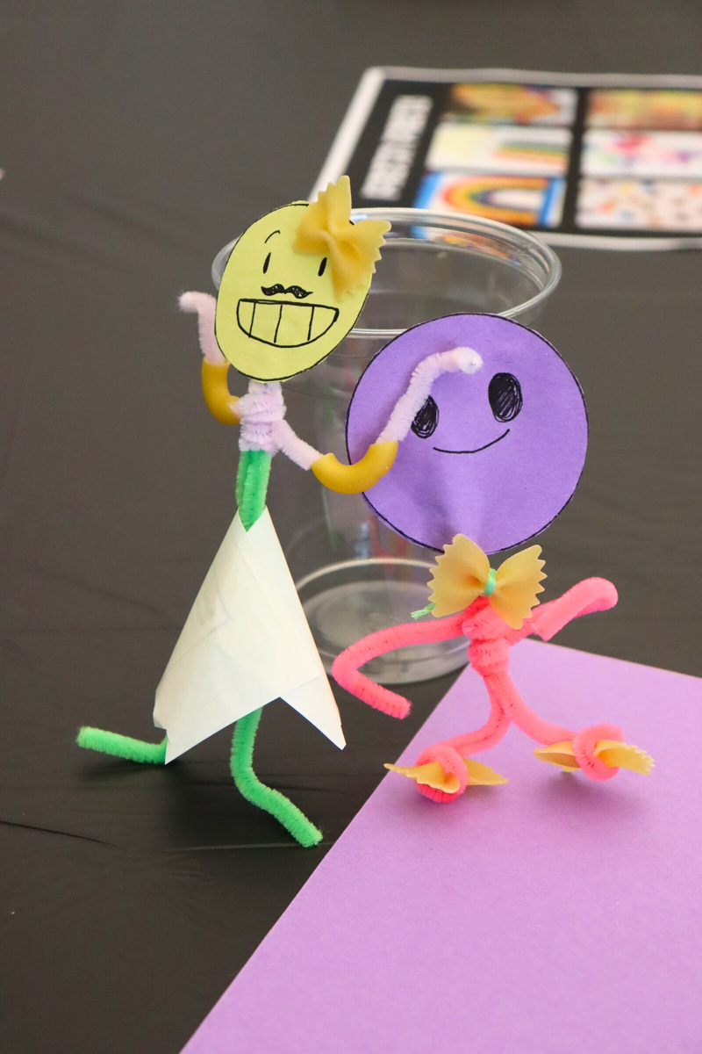
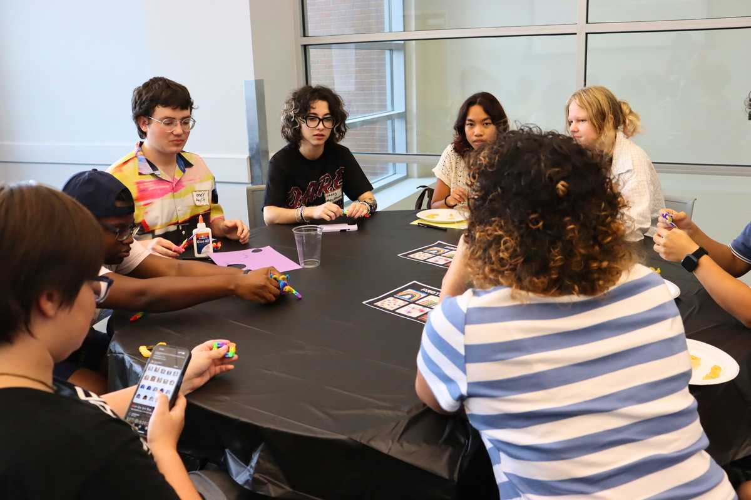
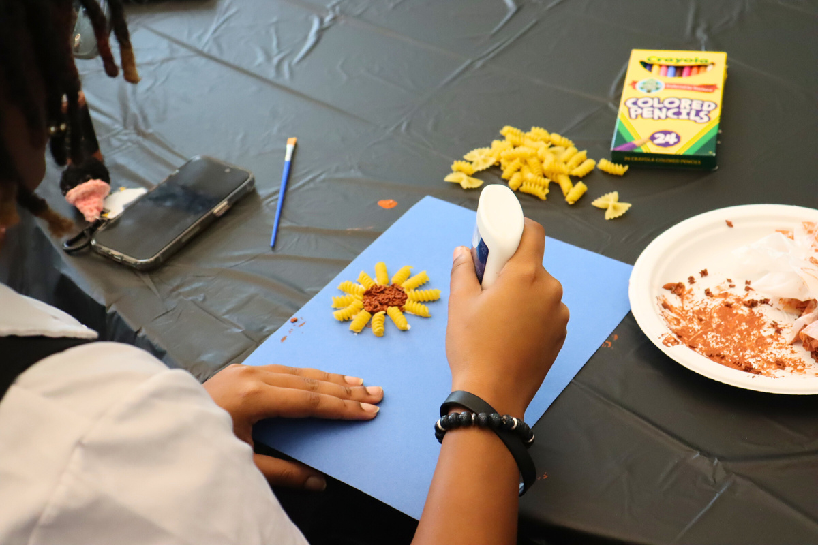
Notes:
Playlist: https://music.youtube.com/playlist?list=PLSx6jNK_G0OW1Q7Z2Xnv-goX6dcGu462m&si=cc0wDj5he8IH6QG3

Slide 3

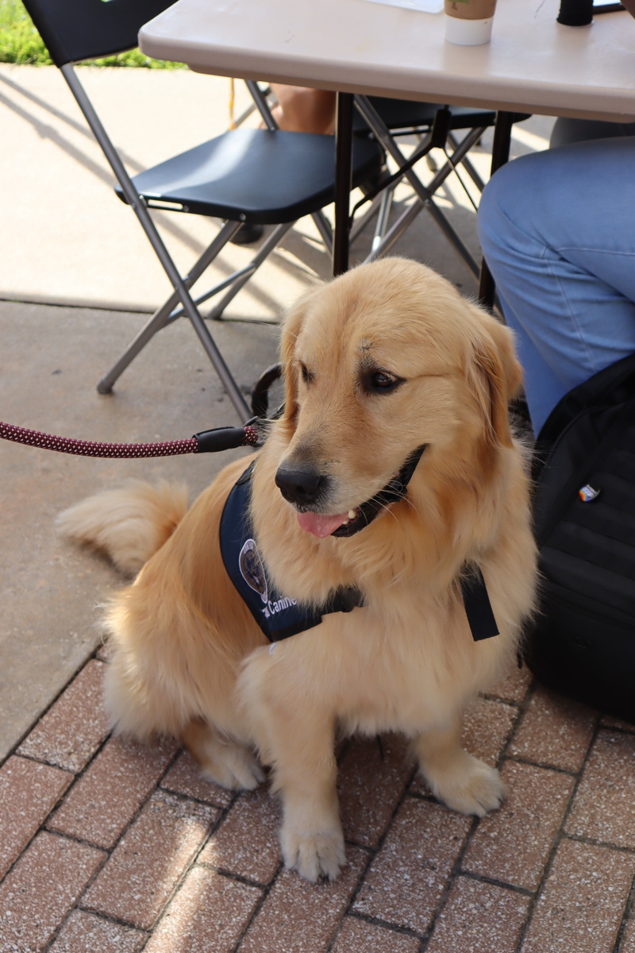
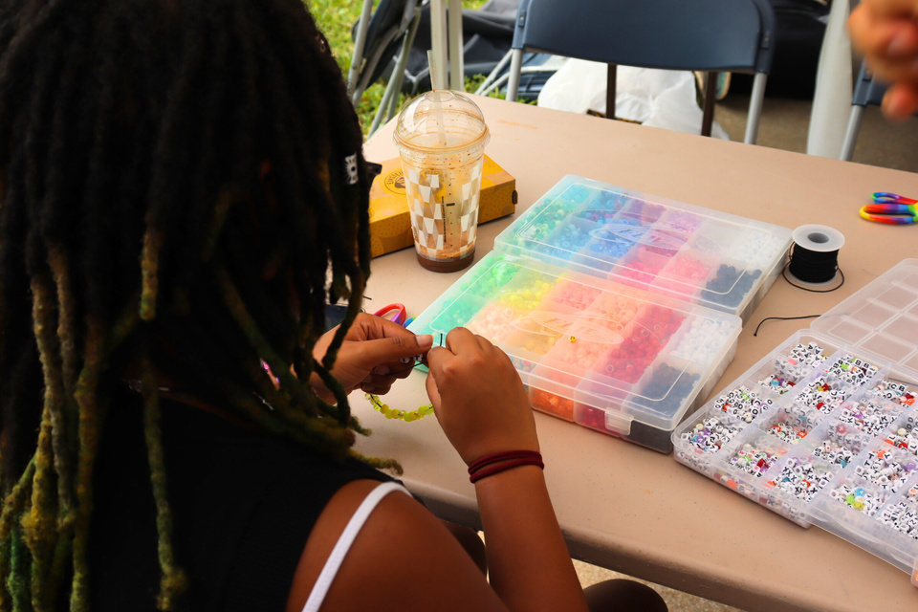


Slide 4
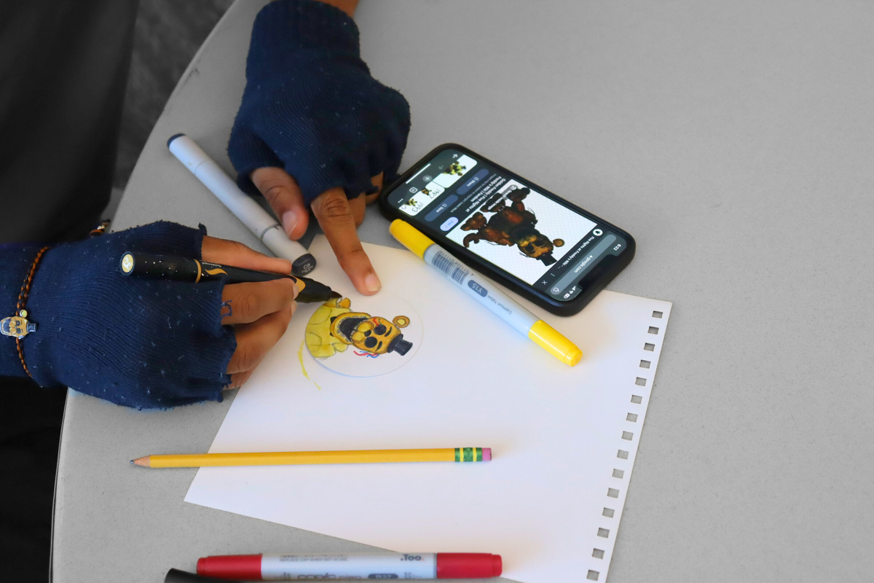
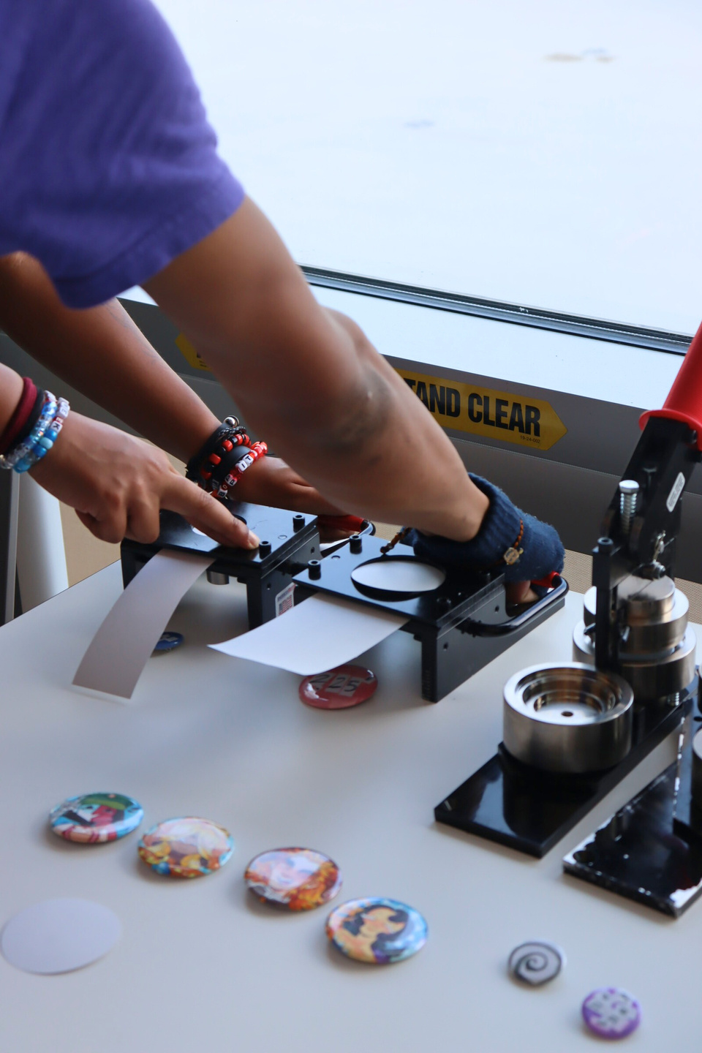
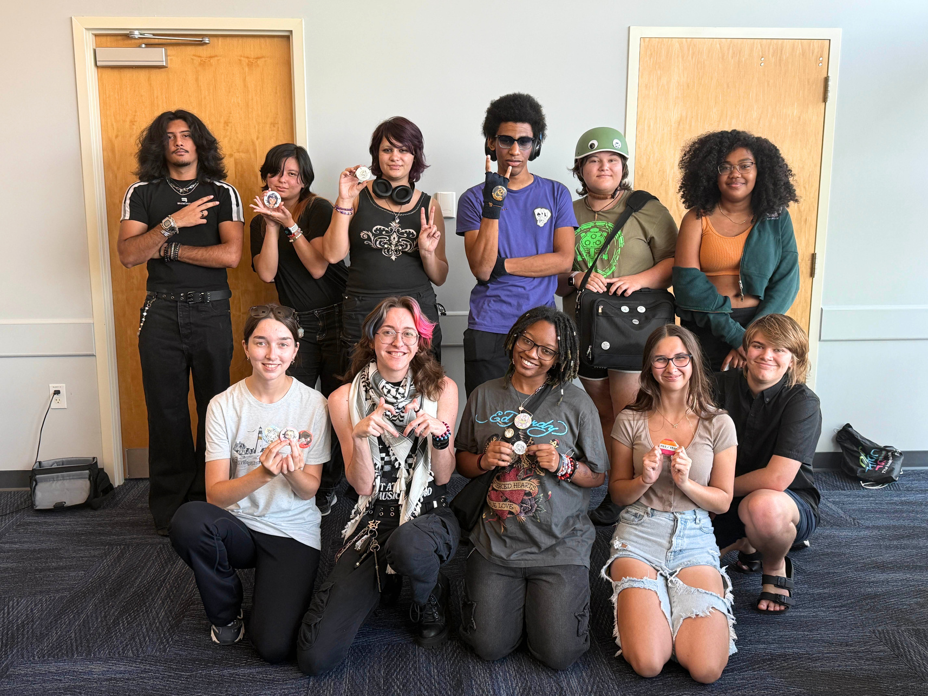
Notes:
Playlist: https://music.youtube.com/playlist?list=PLSx6jNK_G0OW1Q7Z2Xnv-goX6dcGu462m&si=cc0wDj5he8IH6QG3

Slide 5
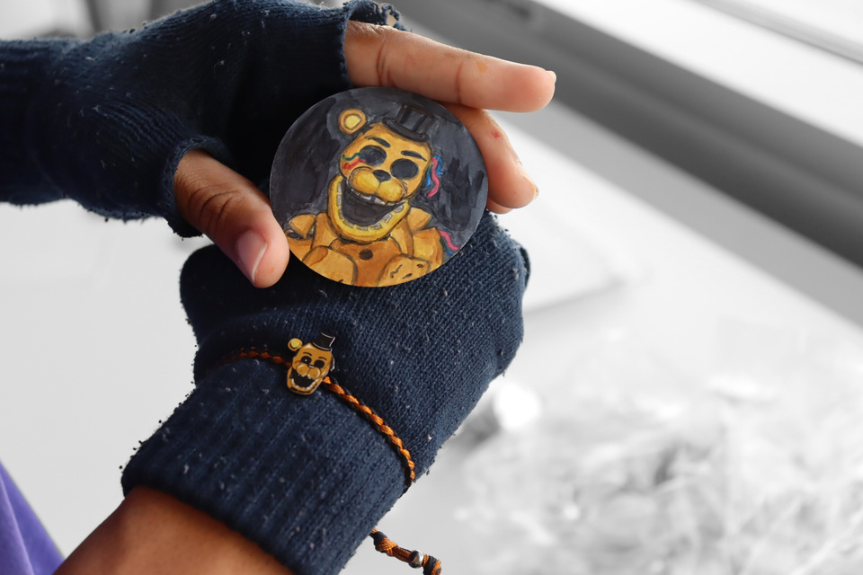
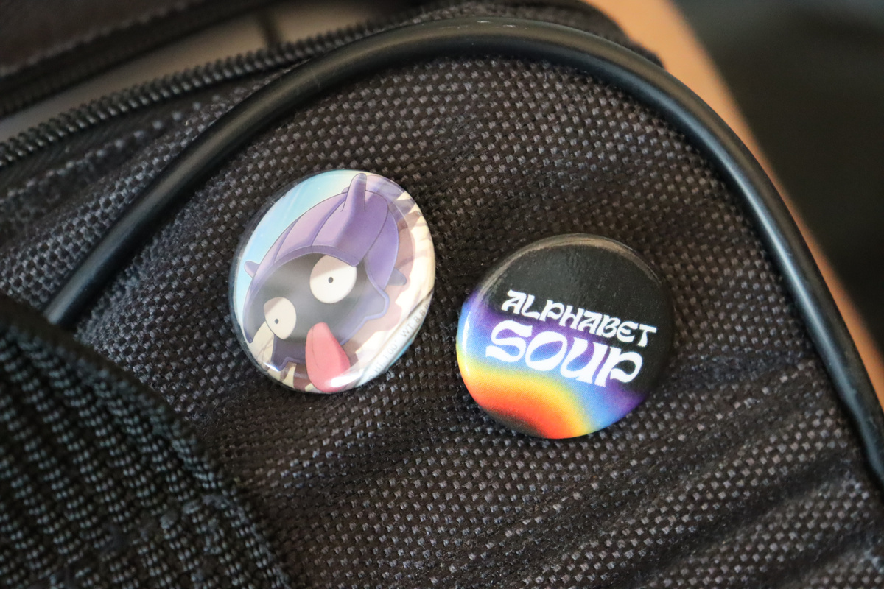
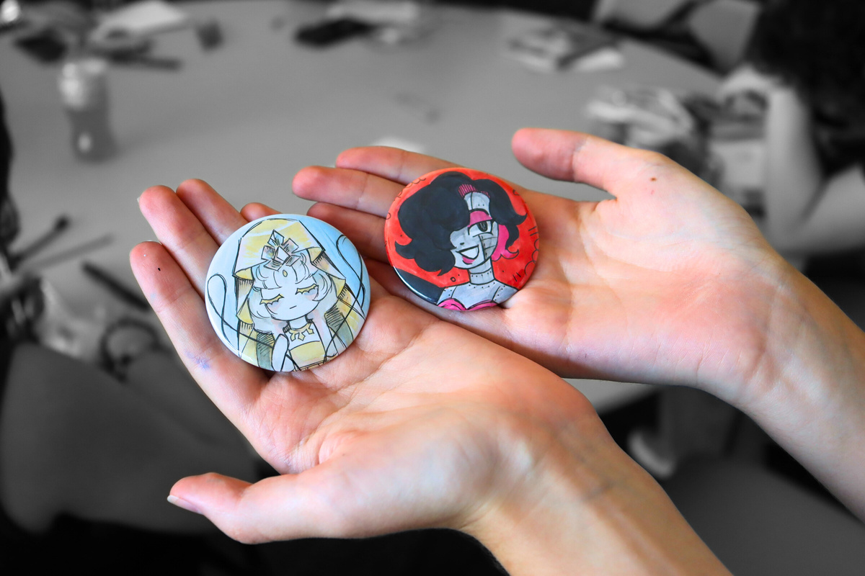
Notes:
Playlist: https://music.youtube.com/playlist?list=PLSx6jNK_G0OW1Q7Z2Xnv-goX6dcGu462m&si=cc0wDj5he8IH6QG3

Slide 6

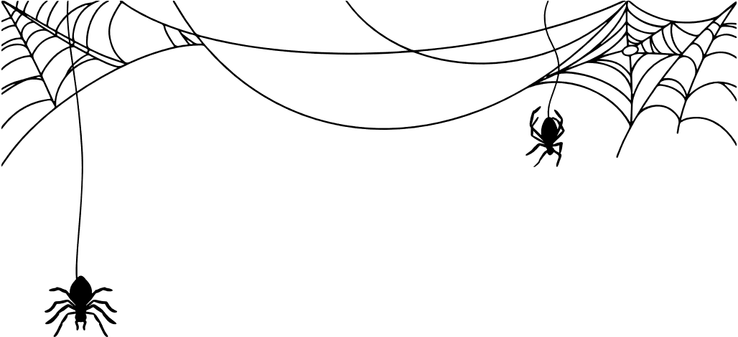

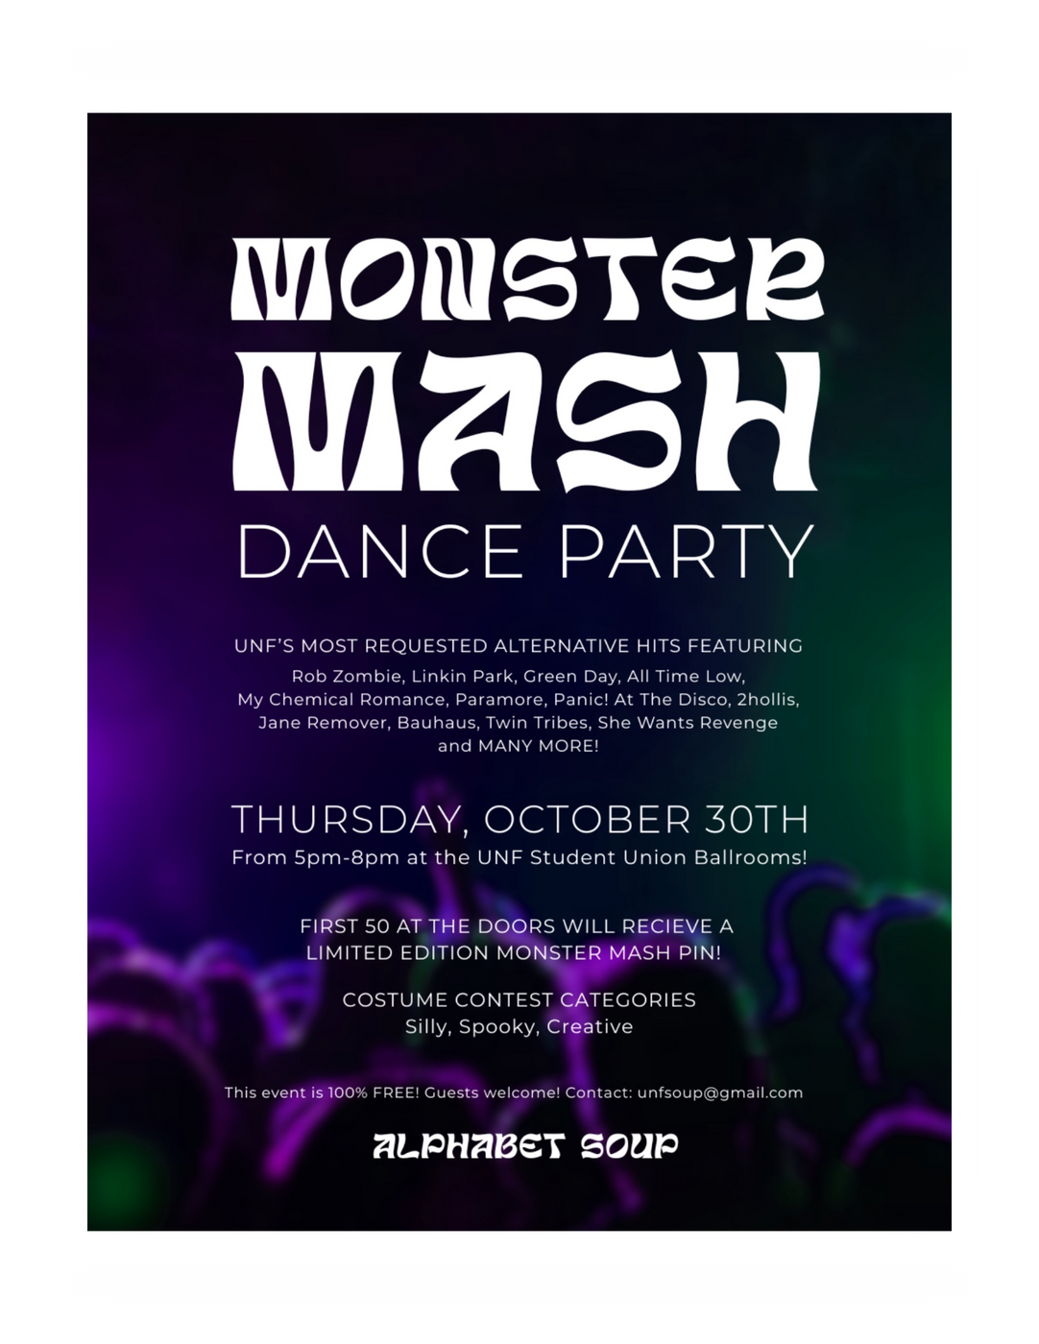
Tomorrow
5-8pm SG Ballroom

Slide 7

WINTER
WALK
RUNWAY SHOW

Slide 8
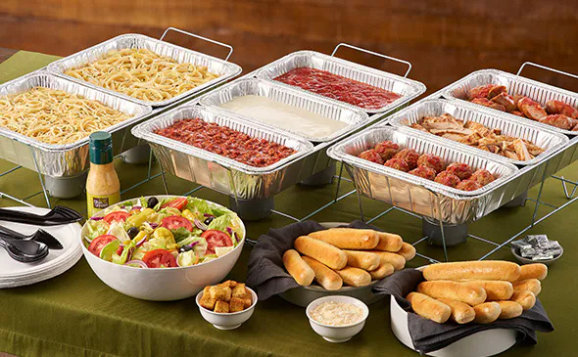
Request #678
3X
Olive Garden’s Pasta Station
2 pastas: Spaghetti and Fettuccine
3 sauces: Alfredo, Meat Sauce and Marinara
3 toppings: Grilled Chicken, Meatballs and Italian Sausage

Slide 9
Thank you! ^^

